Slide 1
House Price Prediction Using Linear Regression
Batta Vaishnavi
AI&ML Task1

Slide 2
Objective
Predict house price using California housing dataset
Learn ML workflow
Data loading
Training
Testing
Evaluation

Slide 3
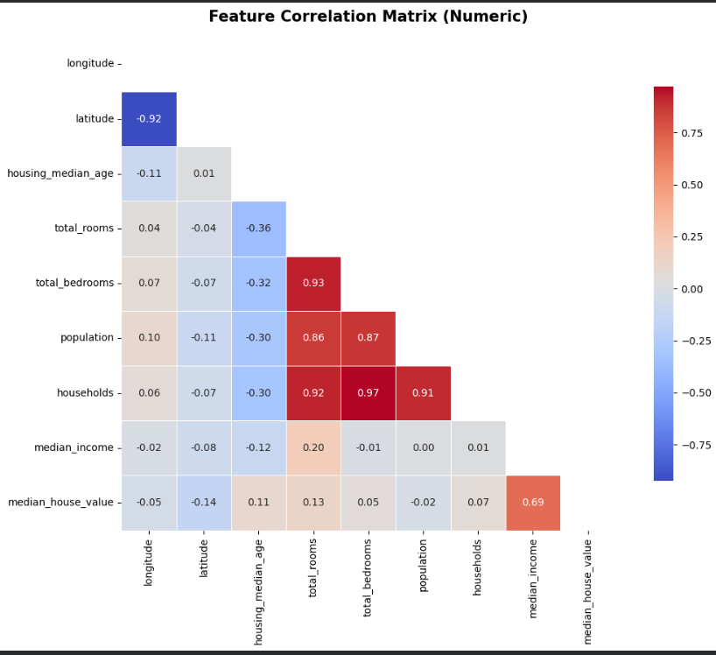
Dataset & EDA
Dataset: California Housing
Checked:
Missing values
Correlation
Data distribution

Slide 4
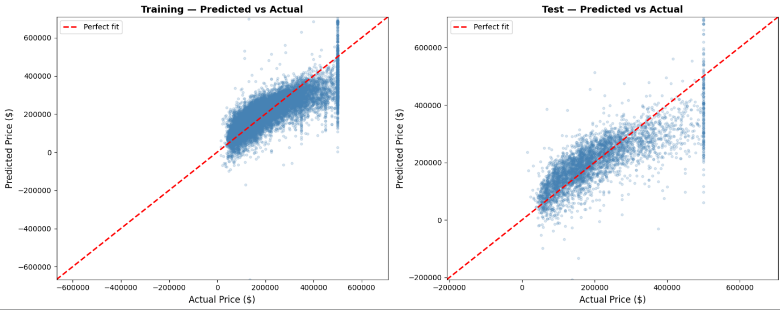
Model Results
--- TRAIN SET ---
MAE : $ 50,627
RMSE : $ 69,361
R² : 0.6401
--- TEST SET ---
MAE : $ 51,821
RMSE : $ 71,148
R² : 0.6137

Slide 5
Conclusion
The Linear Regression model was successfully trained on the California Housing dataset to predict house prices. The model showed good performance and helped understand how different housing features affect price prediction. This project demonstrated the complete machine learning workflow, including data preprocessing, model training, evaluation, and result visualization.

